Slide 1
ECE 5233 Satellite Communications
Prepared by:
Dr. Ivica Kostanic
Lecture 2: Look angle determination
(Section 2.2)
Spring 2011

Slide 2
Outline
Sub-satellite point
Motion of sub-satellite point
Calculation of elevation and azimuth
Look angle calculation spreadsheet
Look angles to geo-synchronous satellites
Examples
Important note: Slides present summary of the results. Detailed derivations are given in notes.

Slide 3
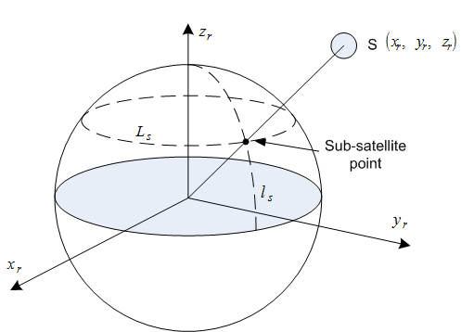
Sub-satellite point
Point at which a line between the satellite and the center of the Earth intersects the Earth’s surface
Location of the point expressed in terms of latitude and longitude
If one is in the US it is common to use
Latitude – degrees north from equator
Longitude – degrees west of the Greenwich meridian
Location of the sub satellite point may be calculated from coordinates of the rotating system as:

Slide 4
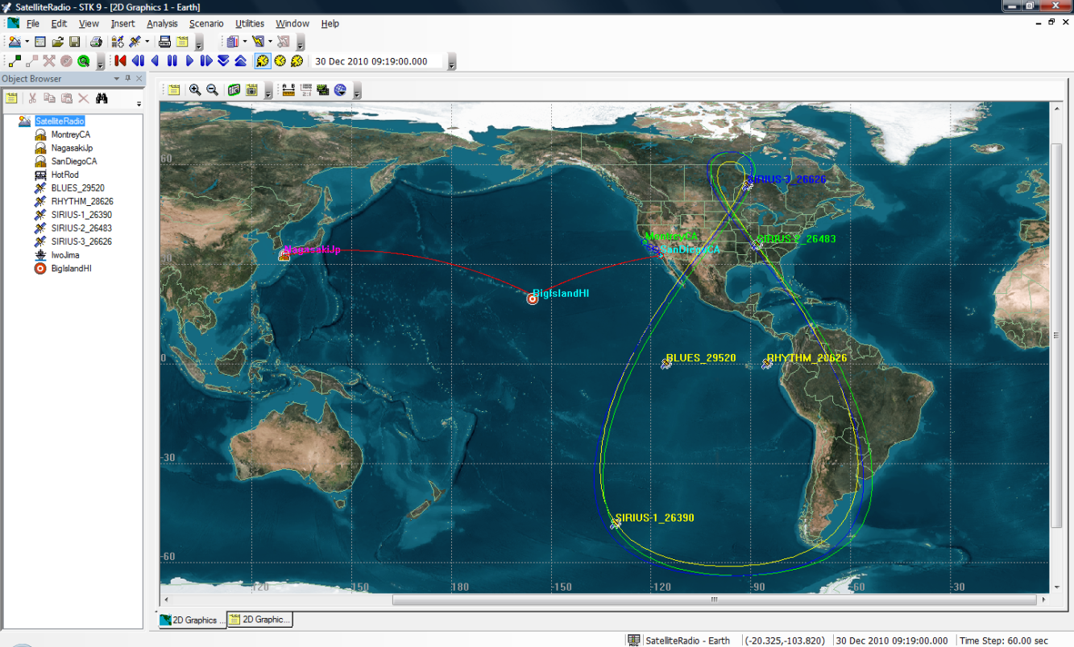
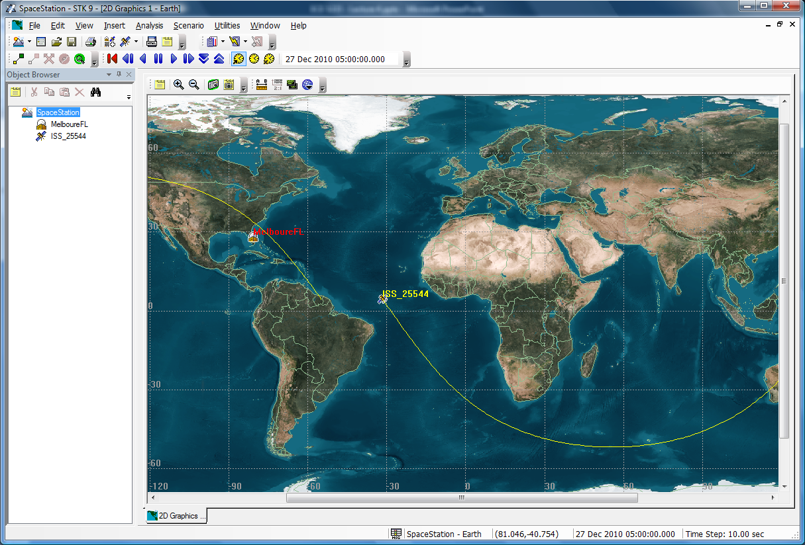
Examples of sub-satellite point trajectories
sub-satellite point used for 2D map display of satellite path
For most satellites the trajectory is part of sinusoidal
For geo-stationary satellites the trajectory is a point
Sirus radio – two geo stationary and three highly inclined orbit satellites
Note: maps are generated using STK by Analytic Graphics, Inc.
International space station – LEO orbit

Slide 5
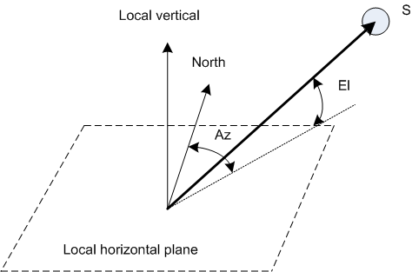
Look angles – elevation (El) and azimuth (Az)
Az – angular distance of the satellite from the north
Az is between 0 and 360 degrees
El – angular distance of the satellite from the local horizontal plane
El is between 0 and 90 degrees
Az and El are required for proper pointing of the Earth station antenna
If the satellite is geo-stationary the antenna is pointed once
If the satellite is on non stationary orbit, the ground system needs to track the Az and El in time
Definition of Az and El

Slide 6
Calculation of elevation
Given:
L_{e} – latitude of Earth Station
l_{e} – longitude of Earth station
L_{s} – latitude of sub-satellite point
l_{s} – longitude of sub-satellite point
r_{s} – distance to satellite
Example: Calculate El for the following data
ES: latitude: 28.06280° N (+0.4898 rad)
longitude: 80.62311° W (+1.4071 rad)
SSP: latitude: 49.5432° N (+0.8647 rad)
longitude: 48.2967°W (+0.8429 rad)
radius, r_{s} = 6738km
Step 1:
Step 2:
Step 2:
Where r_{e} is the radius of the Earth (6370km)

Slide 7
Calculation of azimuth - cases
Eight cases to consider
Northern hemisphere – 4 cases
At least one of the two points (Earth station, sub-satellite point) is in the northern hemisphere
Southern hemisphere – 4 cases
Both points (Earth station and sub-satellite point) are in the southern hemisphere
Given:
L_{e} – latitude of Earth Station
l_{e} – longitude of Earth station
L_{s} – latitude of sub-satellite point
l_{s} – longitude of sub-satellite point
r_{s} – distance to satellite
Note: presented algorithm accommodates general case

Slide 8
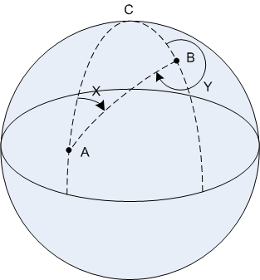
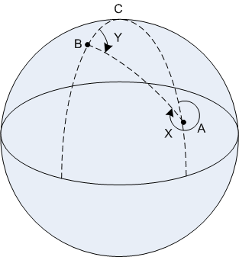
Calculation of azimuth – northern hemisphere
where
A west of B
B west of A
Note: B chosen to be north of A
Case | SSP | ES | Relations | Az (degrees)
1 | A | B | A west of B | 360-Y
2 | B | A | A west of B | X
3 | A | B | B west of A | Y
4 | B | A | B west of A | 360-X
Solve tan equations for X and Y
Identify the case and use table to determine the AZ
SSP- sub-satellite point
ES – Earth station

Slide 9
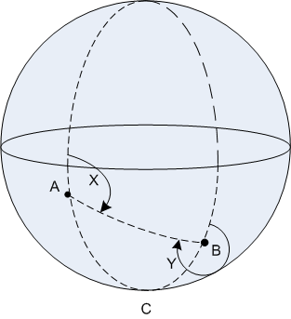
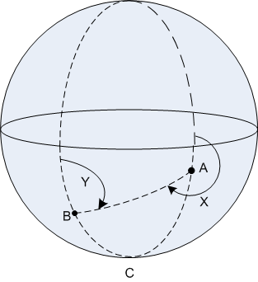
Calculation of azimuth – southern hemisphere
where
A west of B
B west of A
Note: B chosen to be south of A
Case | SSP | ES | Relations | Az (degrees)
1 | A | B | A west of B | 180+Y
2 | B | A | A west of B | 180-X
3 | A | B | B west of A | 180-Y
4 | B | A | B west of A | 180+X
Solve tan equations for X and Y
Identify the case and use table to determine the AZ
SSP- sub-satellite point
ES – Earth station

Slide 10
Azimuth calculation - example
Example: Calculate Az for the following data
ES: latitude: 28.06280° N (+0.4898 rad)
longitude: 80.62311° W (+1.4071 rad)
SSP: latitude: 49.5432° N (+0.8647 rad)
longitude: 48.2967°W (+0.8429 rad)
radius, r_{s} = 6738km
This is Case 2 of Northern hemisphere calculation:
C = |80.62311°-48.2967°|=32.32641°→0.5642 rad
L_{B}=49.5432°→0.8647 rad
L_{A}=28.0628°→0.4898 rad
tan[0.5(Y-X)]=0.8251→0.5(Y-X)=0.6898 rad
tan[0.5(Y+X)]=5.4100→0.5(Y-X)=1.3880 rad
X=0.6982 rad
Y=2.0778 rad
For Case 2 of northern hemisphere:
Az = X = 0.6982 rad →40.0016°

Slide 11
Look angle worksheet

Slide 12
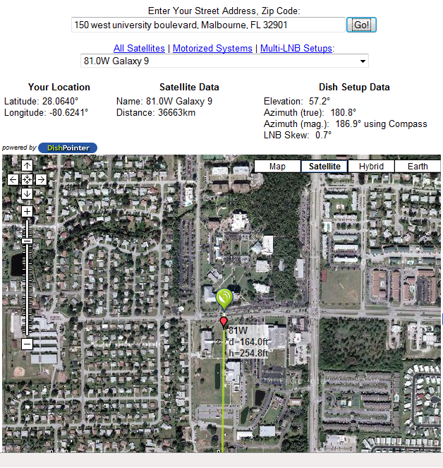
Look angles to geo-stationary satellites
Geo stationary satellites
Occupy non-inclined geo-synchronous orbit
Always above same equatorial point
Location specified using longitude of the sub-satellite point and distance to the satellite
The El/Az calculation spreadsheet “works” for geo-stationary satellites
There are also many websites that calculate El/Az pairs
Example site: http://www.sadoun.com/Sat/Installation/Satellite-Heading-Calculator.htm
VSAT broadcast terminals are usually operating with Geo-stationary satellites
Example of “dish pointer” website
Note: compare pointing results between class spreadsheet and dish-pointing websites

Slide 13
Homework assignment - 3
Problems: 2.5, 2.9 and 2.10

